Slide 1
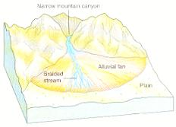
Alluvial Fans تعريف
alluvial fan: a large, fan- or cone-shaped pile of sediment that usually forms where a stream’s velocity decreases as it emerges from a narrow mountain canyon onto a flat plain
Notes:
‹#›

Slide 2
What is an Alluvial Fan?
A Landform
A Sedimentary Deposit Located at a “Topographic Break” (distinct change in the slope of a landform)
Composed of Streamflow and/or Debris Flow deposits
Shaped like a Fan either Fully or Partially Extended

Slide 3
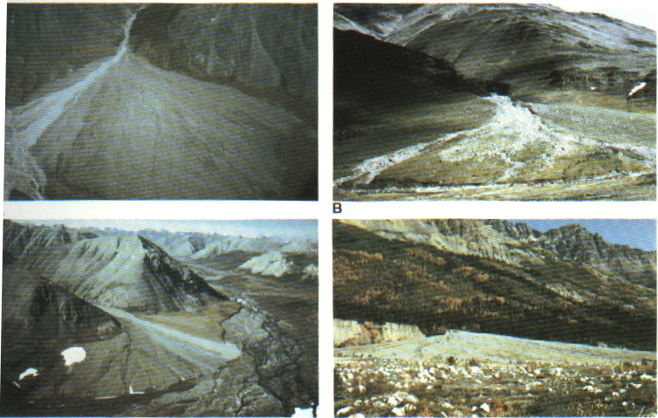
Notes:
‹#›

Slide 4
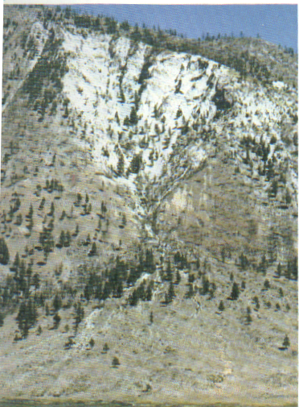
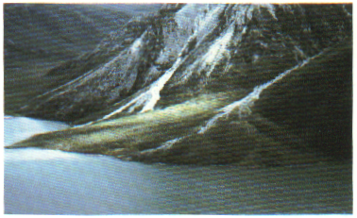
Notes:
‹#›

Slide 5
Notes:
‹#›

Slide 6
Alluvial Fan Facies Models
3 typesحفظ
Debris- flow dominated
Braided fluvial fans
Low- sinuosity/meandering fluvial fan
Generally
lacking fossils
Fan shaped
Texturally immature

Slide 7
Alluvial Fanحفظ Facies Models
Morphology
Proximal, mid-fan, distal
Streamflow processes dominate
Stream- channel sediments
Long narrow bodies of coarsest materials
Poorly sorted
Sheetflood deposits
Sediments settle out of suspension
VERY high sediment load
Deposit gravels even!
Sieve deposits
Very coarse grains are deposited (> sand)
Fines (and water) settle through

Slide 8
3 Alluvial Fan Facies تابعModels
Debris- flow dominated
Poorly sorted
Pebbles, gravels, boulders dominate
No sedimentary structures
Possibly reverse graded bedding in base
Flow is initiated when strength is exceeded
Freezes after short distance
Although some travel up to 24 km (Sharp and Nobles, 1953)
Mud- flow dominated
Similar but sand and muds dominate
Braided Fluvial Fan
Meandering Fluvial Fan

Slide 9
Alluvial to Fluvial Transition
Move downslope, from coarse to fine
Low sediment supply: scoured between systems
High sediment supply: continuous transition to braided streams, then meanders
Steeper slopes
coarser sediments, ephemeral flow
Mountain edges, ice sheets
Rivers are overloaded with sediments
Tend toward BRAIDED streams
Shallower slopes
finer sedimentss, lower velocity flow
Vegetation slows flow on slope; no pre-Devonian meandering streams

Slide 10
Size of fan ranges from less than hundred meters to more than 150 km in radius, although they average less than 10 km.
Kosi River fans In India, which derive sediments from the Hamalayas may be the largest modern fan.
The thickness of fan deposits can range from a few meters to perhaps as much as 25,000m.
Alluvial fan : A) Proximal facies ( highly channelized and lenticular beds). B) Distal facies ( less channelized and sheet like beds).
Fan deposits resulted from stream flow by suspension, saltation and traction by flowing water. It is characteristic of distal fan facies and humid-climate fans. The sedimentary structures are indicative of different flow regimes and generally well stratified.
Fan deposits resulting from debris flow where matrix strength supports clasts and suspended fragments in it. It is characteristic of proximal fan facies and arid-climate fans. The sedimentary structures are generally poorly stratified, contain few sedimentary structures.
Notes:
‹#›

Slide 11
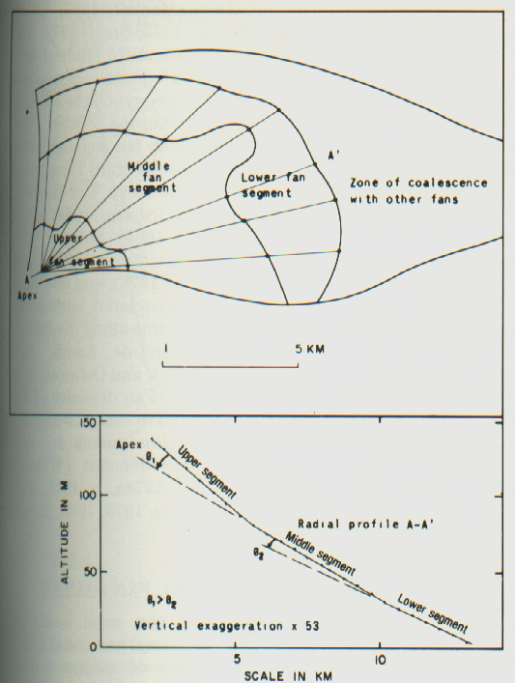
Notes:
‹#›

Slide 12
Fan-delta: is alluvial fan deposited into standing bodies of water. نعريف مهم جدا
Notes:
‹#›

Slide 13
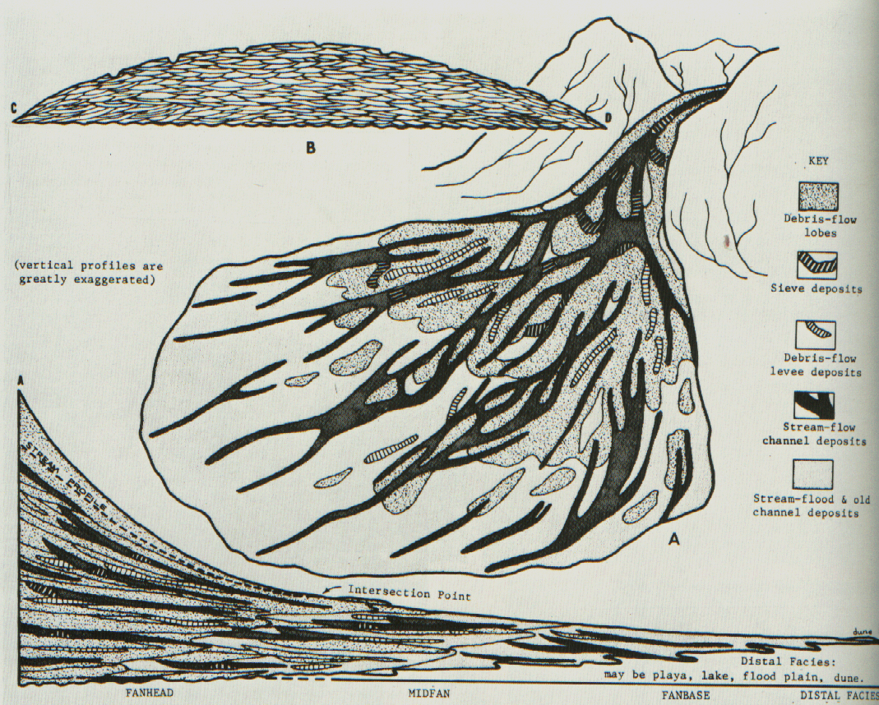
Notes:
‹#›

Slide 14
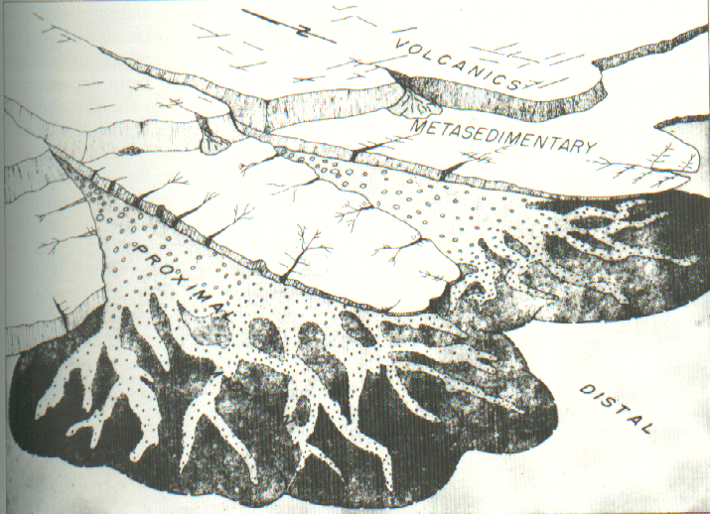
Notes:
‹#›

Slide 15
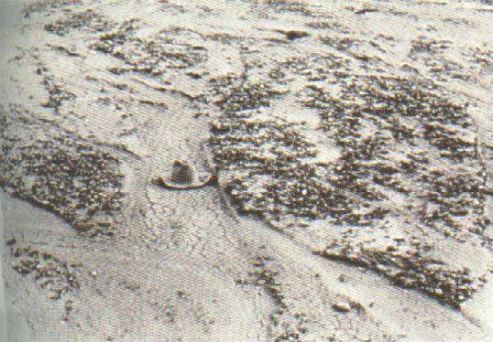
Notes:
‹#›

Slide 16
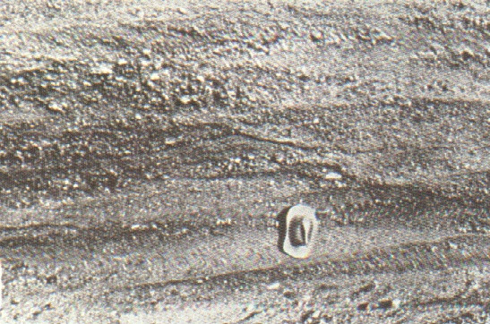
Notes:
‹#›

Slide 17
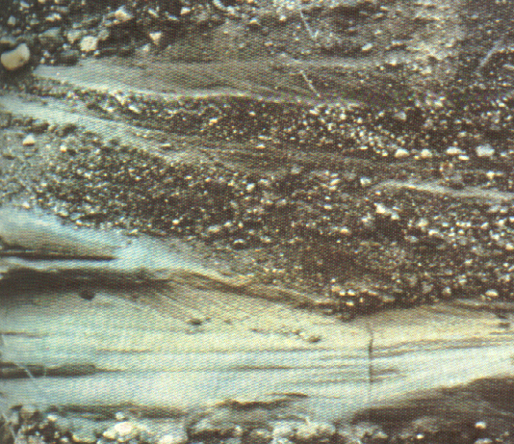
Notes:
‹#›

Slide 18
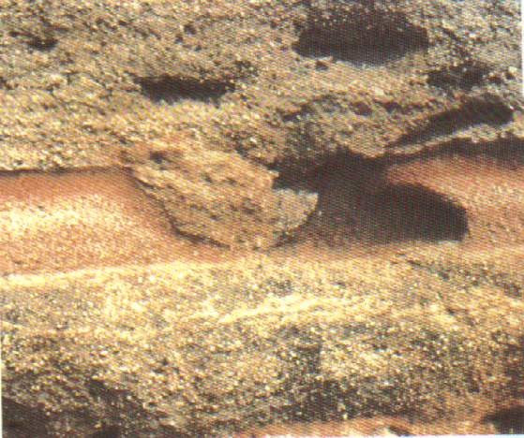
Notes:
‹#›

Slide 19
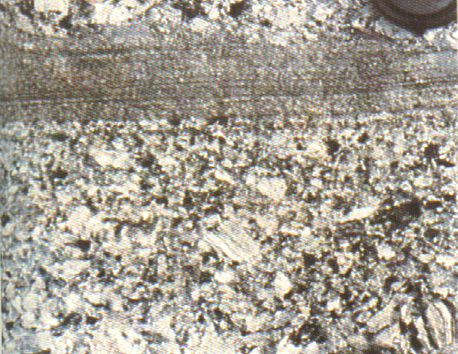
Notes:
‹#›

Slide 20
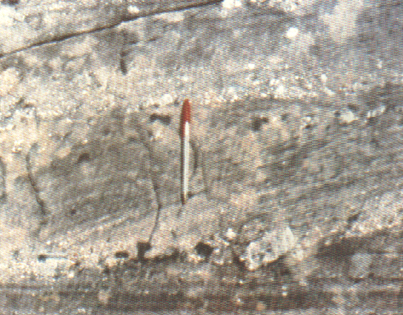
Notes:
‹#›

Slide 21
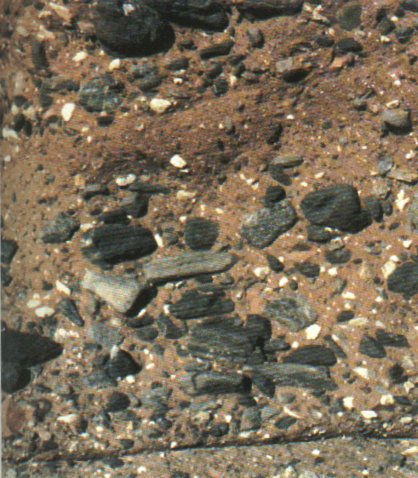
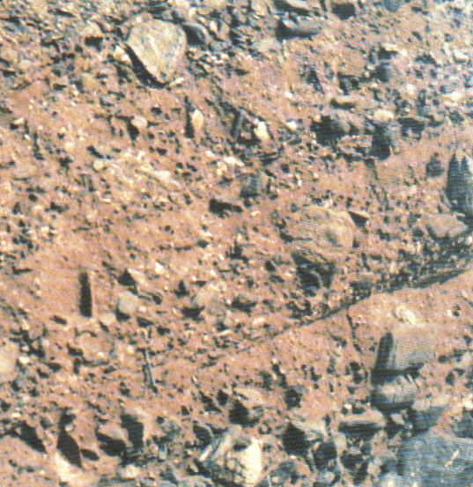
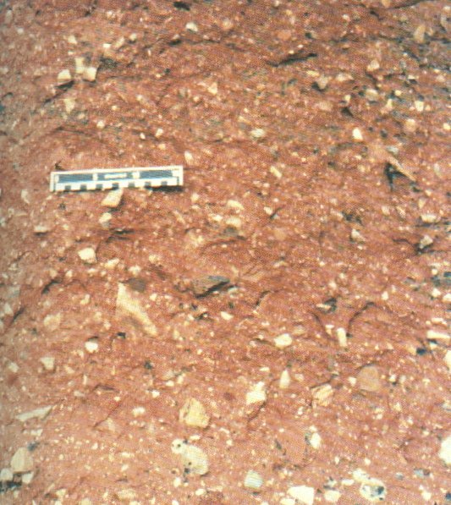
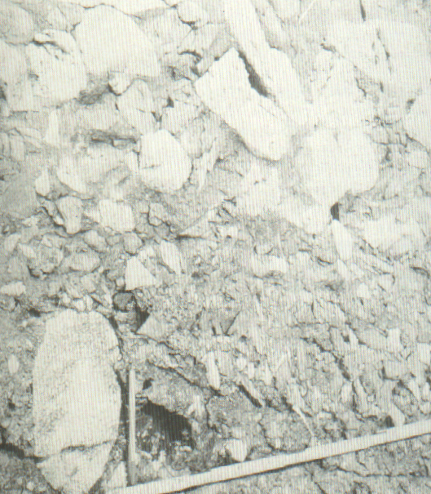
Notes:
‹#›

Slide 22
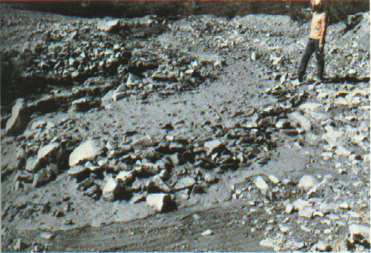
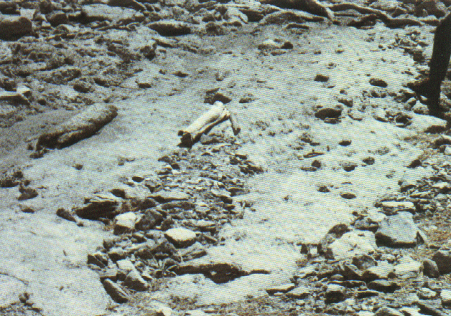
Notes:
‹#›

Slide 23
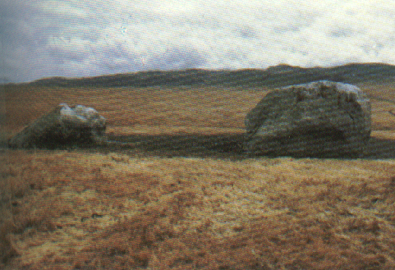
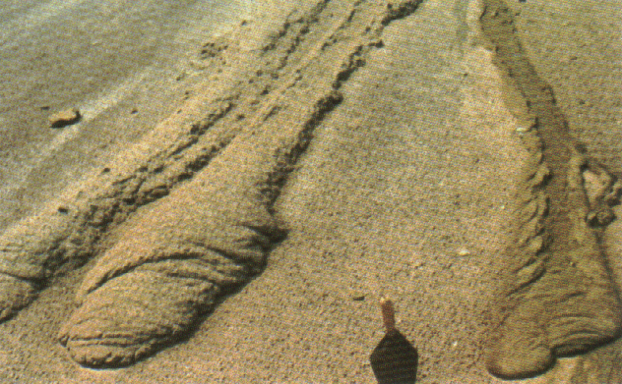
Notes:
‹#›

Slide 24
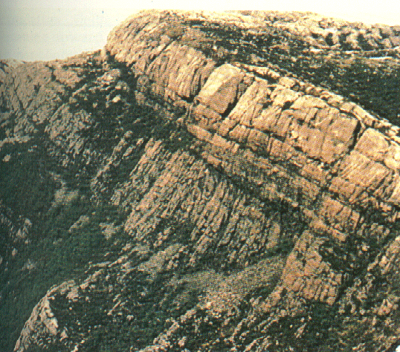
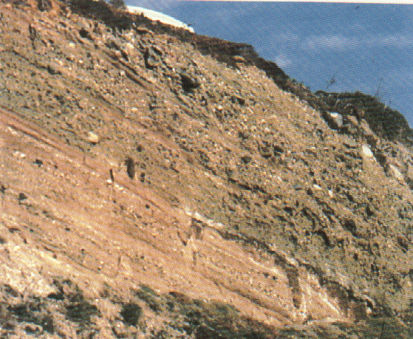
Notes:
‹#›

Slide 25
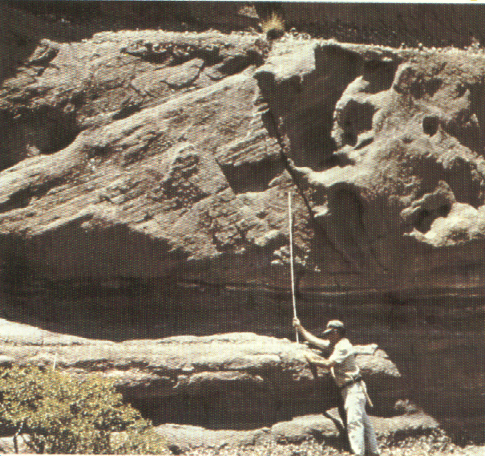
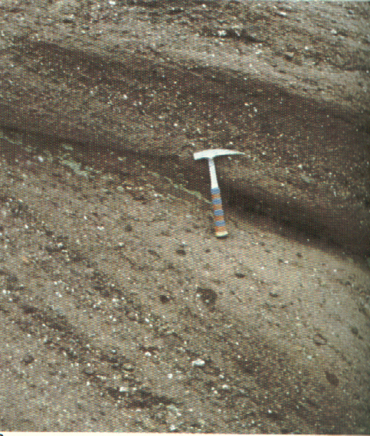
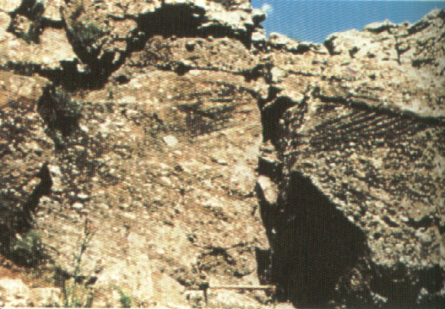
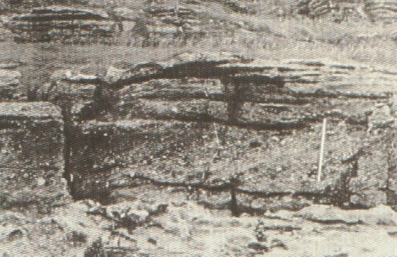
Notes:
‹#›

Slide 26
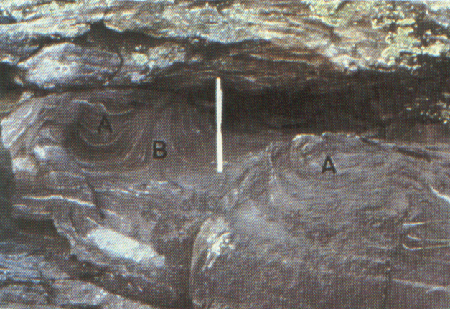
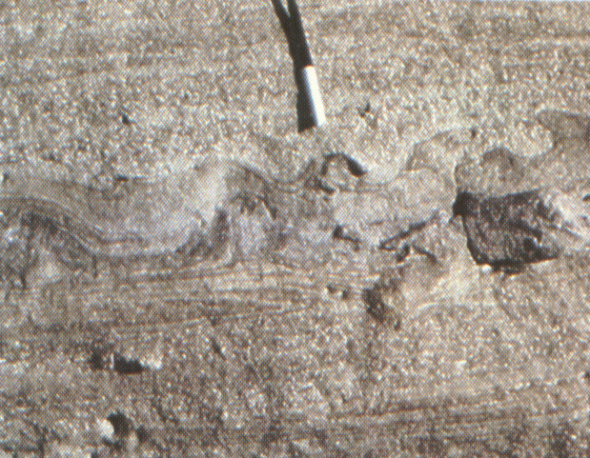
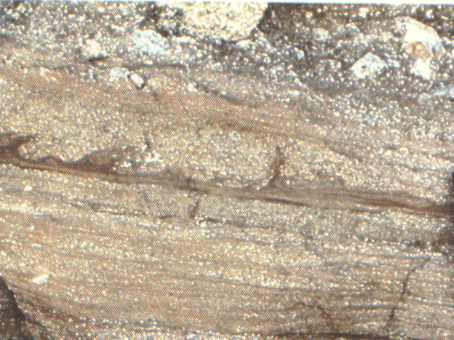
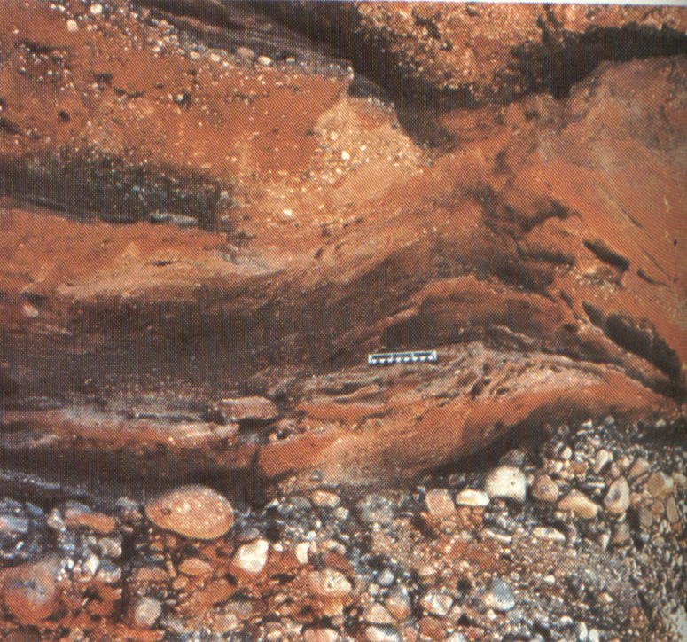
Notes:
‹#›

Slide 27
Criteria for Recognition of Alluvial Fan Deposits كيف تميز رواسب الالوفيل فان حفظ ع الاقل 10 1. Sediments deposited relatively close to their source area. 2. Sediments deposited by unidirectional fluid flows. 3. Sediments deposited by high-energy flows. 4. Sediments typically very poorly sorted, containing a great range in grain sizes. 5. Clasts poorly rounded, reflecting the short distance of transport. 6. Sediments compositionally immature and having a great range in composition, depending on the types of rocks present in the source area. 7. Sediments characterized by major changes in lateral and vertical facies, particularly in the downfan direction. 8. Sediments characterized by rapid downfan decreases in both average and maximum clast size.
Notes:
‹#›

Slide 28
9. Sediments generally oxidized, typically never having been placed in reducing conditions; characteristic colors are red, brown, yellow, or orange. 10. Sediments generally not containing large amounts of organic matter because of oxidizing conditions of sedimentation. 11. Sediments generally not containing many fossils except for scattered vertebrate bones and plant fragments. 12. Sediments generally containing a limited suite of sedimentary structures, most commonly medium – to large – scale cross-strata and planar stratification. 13. Depositional bodies having a lenticular or wedge-shaped geometry and typically forming clastic wedges.
Notes:
‹#›

Slide 29
14. Depositional bodies consisting of a mixture of partly sorted streamflow deposits and unsorted debris-flow and mudflow deposits. 15. Depositional bodies extensively channelized, consisting dominantly of sediment-filled channels of varied depth and width with generally little lateral continuity. 16. Depositional bodies generally poorly stratified, ranging from unstratified debris flow and mudflow deposits to better stratified streamflow deposits. 17. Depositional bodies changing laterally in composition because each fan of a coalesced group of fans is fed typically by an individual mountain stream that may drain an area underlain by distinctive bedrock units.
Notes:
‹#›

Slide 30
18. Depositional bodies commonly associated with fault-bounded basins such as grabens, half-grabens, and various types of strike-slip fault-bounded basins. 19. Depositional bodies in which streamflow and debris-flow deposits interfinger distally or downfan with finer grained alluvial plain, eolian, lacustrine, or marine facies. 20. Depositional bodies containing abundant soil profiles and terrace surfaces. 21. Depositional bodies containing salts such as gypsum or calcite deposited interstitially, within soils, and as caliche layers. 22. Paleocurrent patterns radiating outward downfan in individual fans and having complex radiating patterns in coalesced alluvial fans. 23. Depositional bodies that include sieve deposits, which are not characteristic of other terrestrial facies.
Notes:
‹#›

